Slide 1
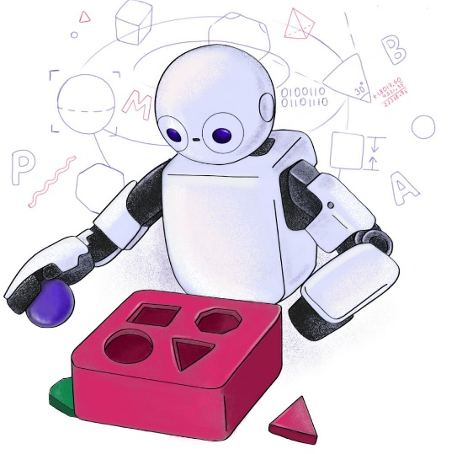

TP555 - Inteligência Artificial e Machine Learning: Aprendizagem por Transferência
Felipe Augusto Pereira de Figueiredo
felipe.figueiredo@inatel.br

Slide 2
https://neptune.ai/blog/transfer-learning-guide-examples-for-images-and-text-in-keras
https://towardsdatascience.com/a-comprehensive-hands-on-guide-to-transfer-learning-with-real-world-applications-in-deep-learning-212bf3b2f27a
https://machinelearningmastery.com/how-to-use-transfer-learning-when-developing-convolutional-neural-network-models/

Slide 3
Obrigado!

Slide 4
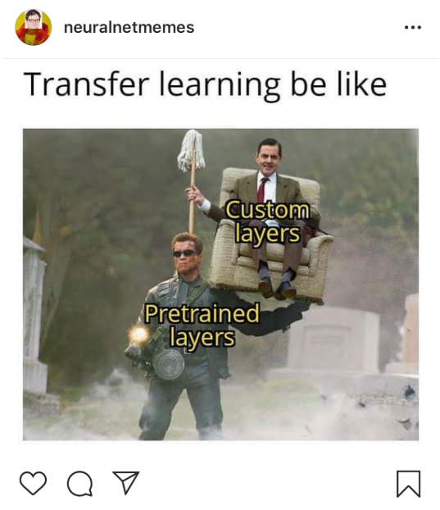
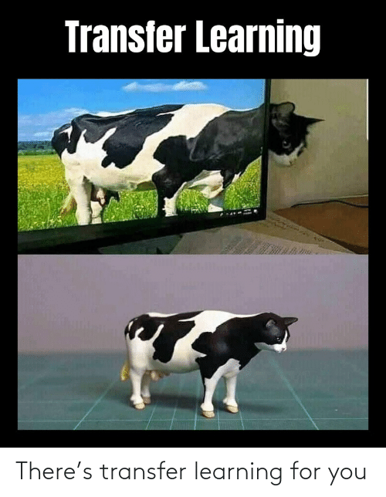


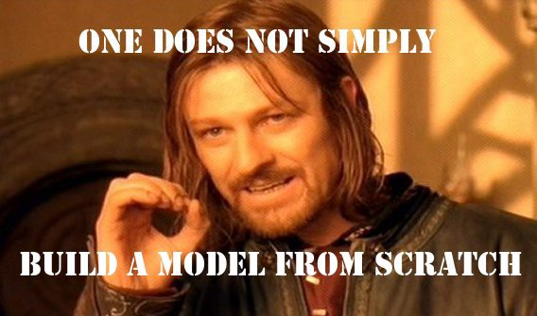
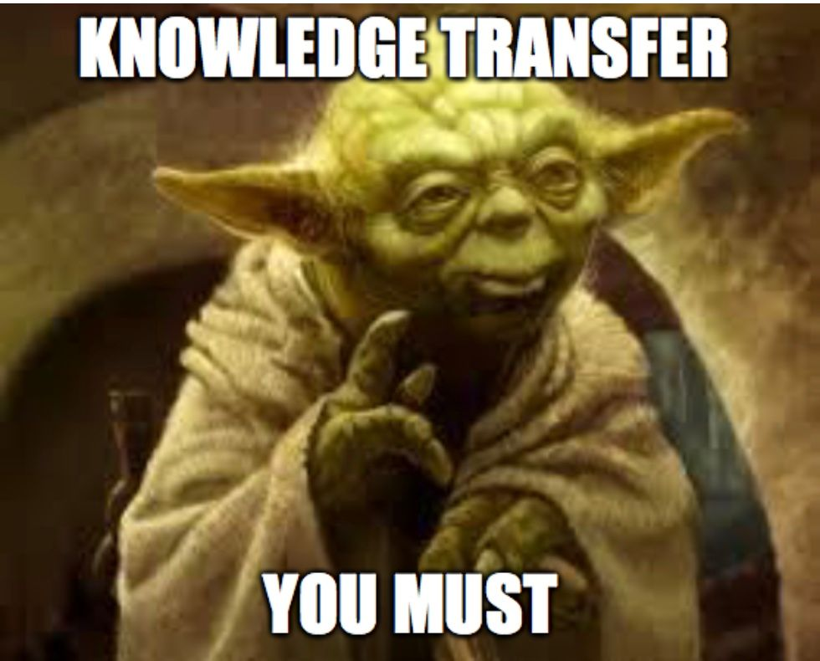

Slide 5
Figuras

